Slide 1
Configuration Management

Slide 2
Introduction
Version Control Systems
Puppet

Slide 3
Version Control Systems

Slide 4
Version Control Systems
Keeps track of changes over time
You see it everywhere and probably don't realize it
document editors; spreadsheets; wiki; content management systems
Two main types
centralized
distributed

Slide 5
Version Control Systems
Centralized
CVS
Subversion (SVN)
...
Distributed
Git
Mercurial
Bazaar
...

Slide 6
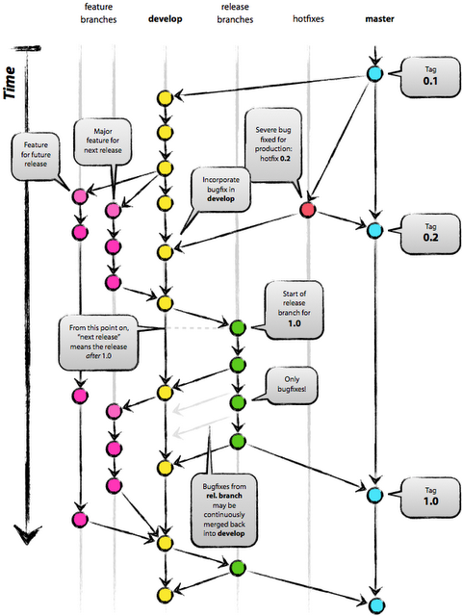
Version Control Systems
Distributed Workflow
Revolves around branching and merging changes
Can get complicated
but makes sense once you understand what's going on
Notes:
image: http://nvie.com/posts/a-successful-git-branching-model/

Slide 7

Git
Introduction
Developed by Linus Torvalds
claims he named it after himself
Written for high-performance
Distributed development
Efficient with large projects
Really good merge algorithms
"git: A foolish or worthless person"
- Mirriam-Webster
Notes:
image: http://git-scm.com/images/logo@2x.png

Slide 8
Git
Even More Features!
Very portable
windows, linux, mac
Lots of good hosting options
github, gitorious, sourceforge, google code
Works with many protocols
http, rsync, ftp, ssh, email, and 'git'
Has event 'hooks'

Slide 9
Puppet

Slide 10
Configuration Management
Overview
CFEngine [1993]
Puppet [2005]
Chef [2009]
Salt [2011]
Ansible [2012]
[…]

Slide 11

Puppet
Overview
Completely automate configuration of your entire IT infrastructure
Scripts are based on Ruby syntax
but has own quirks/bugs
steep learning curve
Provided virtual environment for testing and learning
In my experience, if you're only doing simple things, it's awesome. But, when you try to do something complicated, it breaks down quickly.

Slide 12

Puppet
Puppet Master
Server nodes are called 'masters'
Can be queried by child node to get configuration
usually done at a regular interval
Can push changes immediately to child nodes
Uses Git for version control (typ.)

Slide 13
Puppet
Core Types
Ensure that users exist on a system
and have certain credentials
including sudo permissions
Ensure that a package is installed
works with yum, aptitude and others!
Ensure that a service is running
file changes can trigger service restarts
Ensure that configuration files have proper content
Execute remote commands
Setup `cron` jobs to run at regular intervals

Slide 14
Puppet
Syntax Class Declarations
Simplified syntax works well with simple cases
Package['ntp'] -> File['/etc/ntp.conf'] ~> Service['ntpd']
More complex stuff requires full definitions
class sshd {
file { 'sshdconfig': path => $operatingsystem ? { solaris => '/usr/local/etc/ssh/sshd_config', default => '/etc/ssh/sshd_config', }, owner => 'root', group => 'root', mode => '0644', }
service { 'sshd': require => File['sshdconfig', 'sshconfig', 'authorized_keys'], require +> Package['openssh-server'], }
}

Slide 15
Puppet
Syntax Node Definitions
node compute {
include common # common has sshd, dhclient, etc.
include modulecmd, openmpi
}
node head inherits compute {
include named, dhcpd, apache
include autotools, gcc, intel-compiler
}
node /^hn\d+$/ inherits head { }
node /^cn\d+$/ inherits compute { }

Slide 16
Summary

Slide 17
Summary
Overview
Version Control Systems
Puppet

Slide 18
Questions

